Slide 1
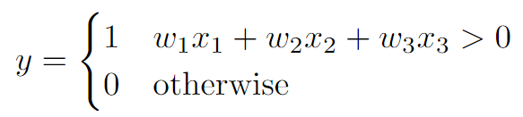
Review: Perceptron
w₁
x₁
Σ
w₂
>0?
x₂
y
w₃
x₃
Notes:
$$y = \begin{cases}1 & w_1 x_1 + w_2 x_2 + w_3 x_3 > 0 \\0 & \text{otherwise}\end{cases}$$
1

Slide 2
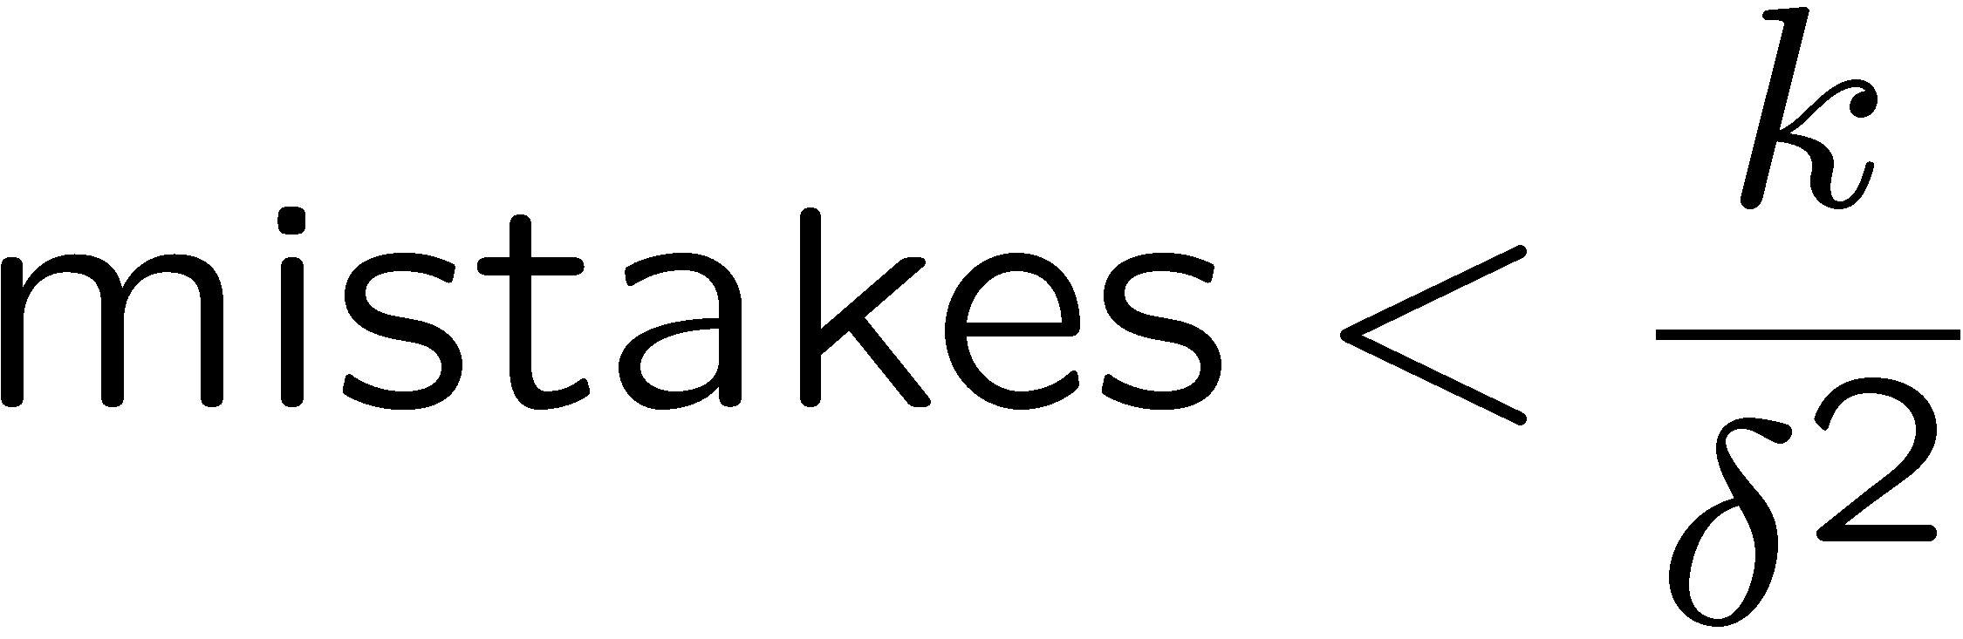
Properties of Perceptrons
Separable
Separability: true if some parameters get the training set perfectly correct
Convergence: if the training is separable, perceptron will eventually converge (binary case)
Mistake Bound: the maximum number of mistakes (binary case) related to the margin or degree of separability
Non-Separable

Slide 3
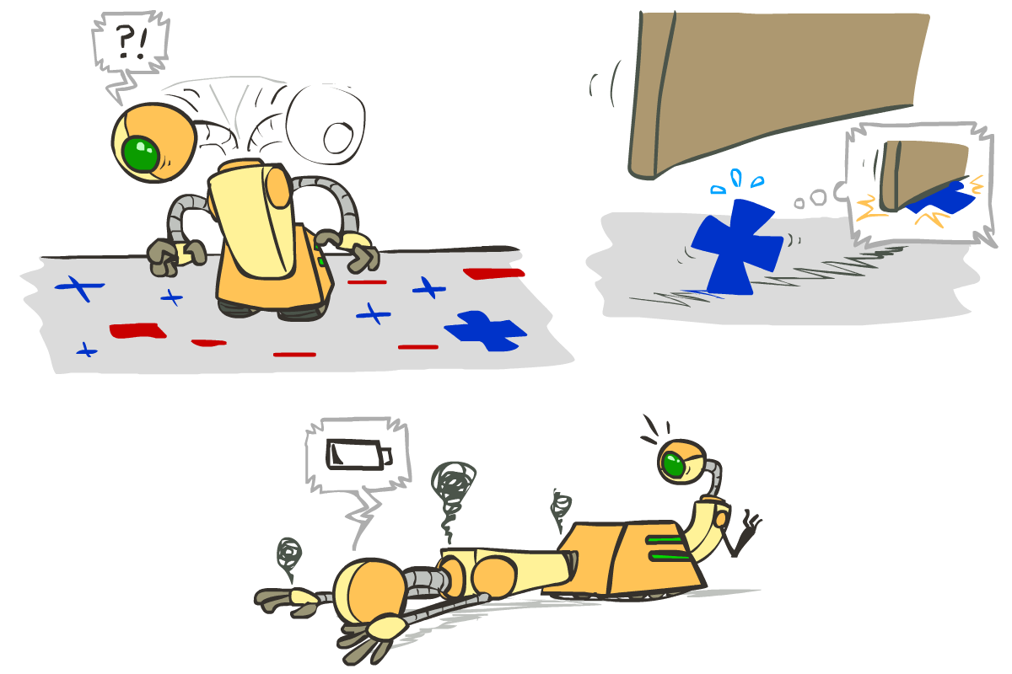





Problems with the Perceptron
Noise: if the data isn’t separable, weights might thrash
Averaging weight vectors over time can help (averaged perceptron)
Mediocre generalization: finds a “barely” separating solution
Overtraining: test / held-out accuracy usually rises, then falls
Overtraining is a kind of overfitting

Slide 4

Improving the Perceptron

Slide 5
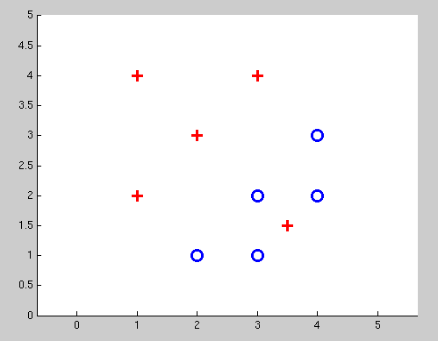
Non-Separable Case: Deterministic Decision
Even the best linear boundary makes at least one mistake

Slide 6
Non-Separable Case: Probabilistic Decision
0.9 | 0.1
0.7 | 0.3
0.5 | 0.5
0.3 | 0.7
0.1 | 0.9

Slide 7
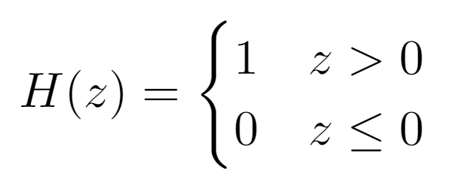
How to get deterministic decisions?
Perceptron scoring:
If positive → classifier says: 1.0 probability this is class +1
If negative → classifier says: 0.0 probability this is class +1
Step function
z = output of perceptron H(z) = probability the class is +1, according to the classifier
H(z)
1
z
0

Slide 8
How to get probabilistic decisions?
Perceptron scoring:
If very positive → probability of class +1 should approach 1.0
If very negative → probability of class +1 should approach 0.0
Sigmoid function
z = output of perceptron = probability the class is +1, according to the classifier

Slide 9
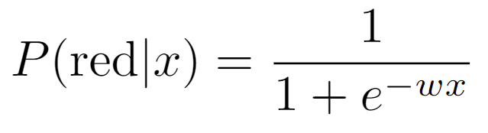
Probabilistic Decisions: Example
where w is some weight constant (vector) we have to learn, and wx is the dot product of w and x
Suppose w = [–3, 4, 2] and x = [1, 2, 0]
What label will be selected if we classify deterministically?
wx = –3+8+0 = 5
5 is positive, so the classifier guesses the positive label
What are the probabilities of each label if we classify probabilistically?
1 / (1 + e^{–5}) = 0.9933 probability of positive label
1 – 0.9933 = 0.0067 probability of negative label

Slide 10
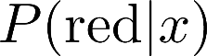


A 1D Example
where w is some weight constant (1D vector) we have to learn
(assume w is positive in this example)
definitely blue
(x negative)
not sure
(x near 0)
definitely red
(x positive)

Slide 11
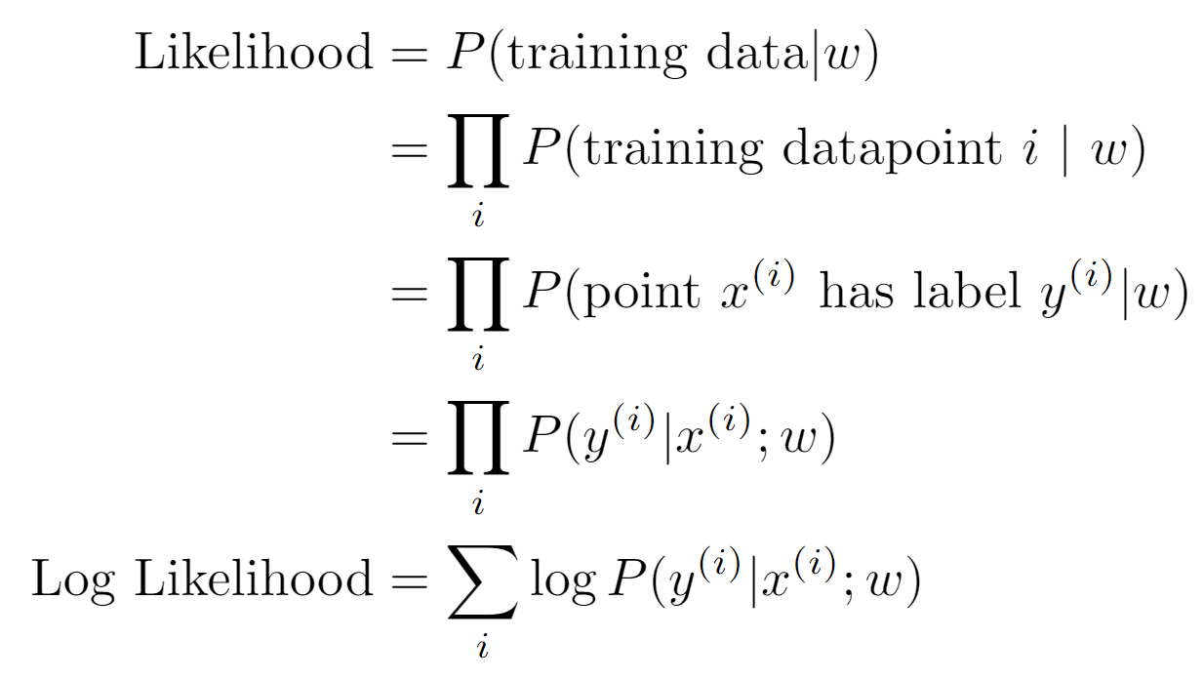
Best w?
Recall maximum likelihood estimation: Choose the w value that maximizes the probability of the observed (training) data

Slide 12
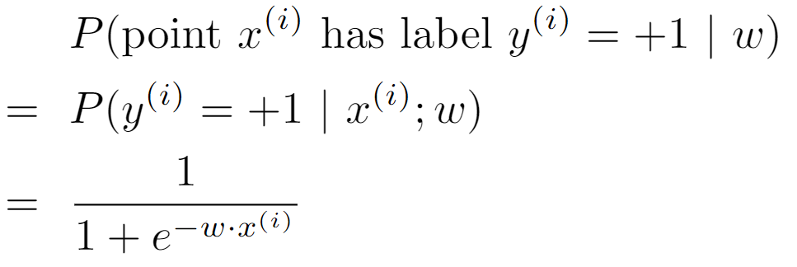
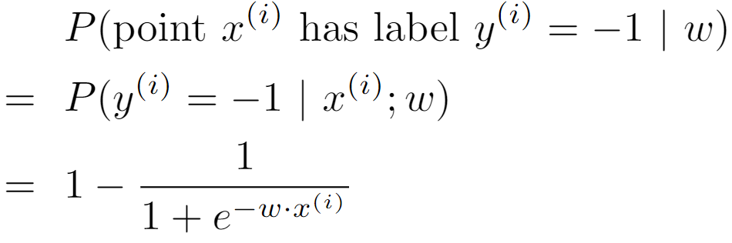
Best w?
Recall maximum likelihood estimation: Choose the w value that maximizes the probability of the observed (training) data

Slide 13
Best w?
Maximum likelihood estimation:
with:
= Logistic Regression

Slide 14
Logistic Regression Example
What function are we trying to maximize for this training data?
Data point [2, 1] is class +1
Data point [0, –2] is class +1
Data point [–1, –1] is class –1
+
–
+

Slide 15
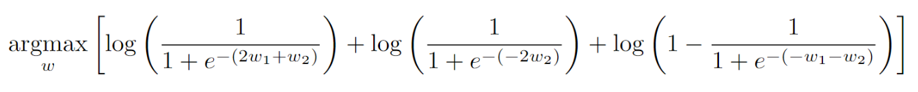
Logistic Regression Example
What function are we trying to maximize for this training data?
Data point [2, 1] is class +1
Data point [0, –2] is class +1
Data point [–1, –1] is class –1
+
–
+
Notes:
$$\argmax_w \left[\log\left(\frac{1}{1 + e^{-(2w_1 + w_2)}}\right) + \log\left(\frac{1}{1 + e^{-(-2w_2)}}\right) + \log\left(1 - \frac{1}{1 + e^{-(-w_1 - w_2)}}\right)\right]$$

Slide 16
Separable Case: Deterministic Decision – Many Options

Slide 17
Separable Case: Probabilistic Decision – Clear Preference
0.7 | 0.3
0.5 | 0.5
0.7 | 0.3
0.3 | 0.7
0.5 | 0.5
0.3 | 0.7

Slide 18
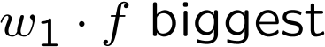


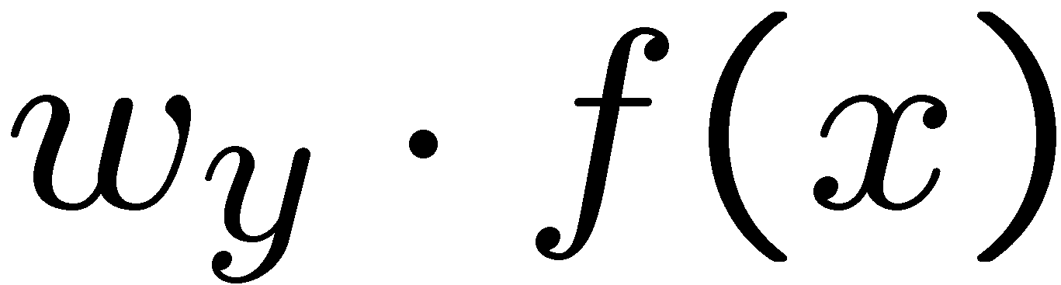

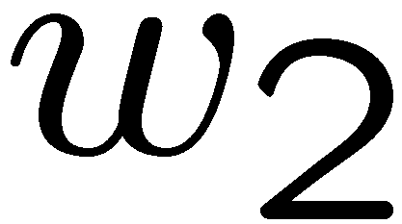
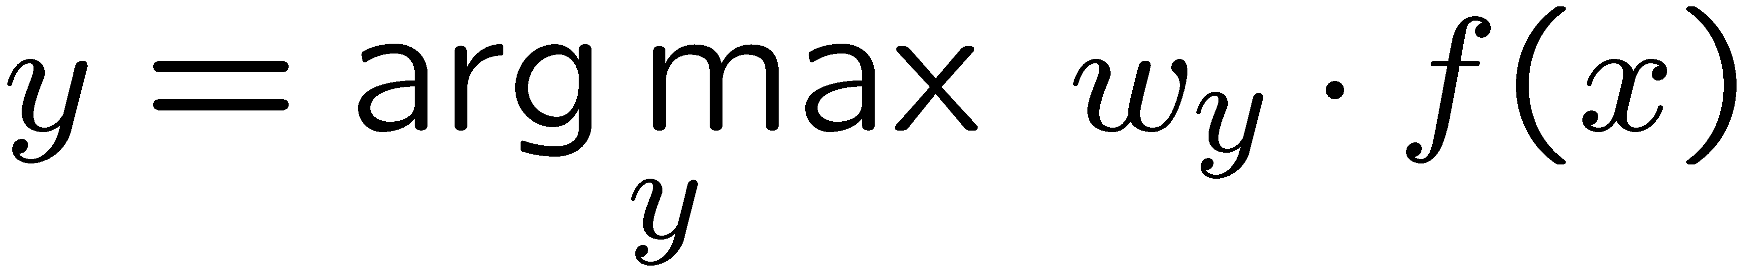
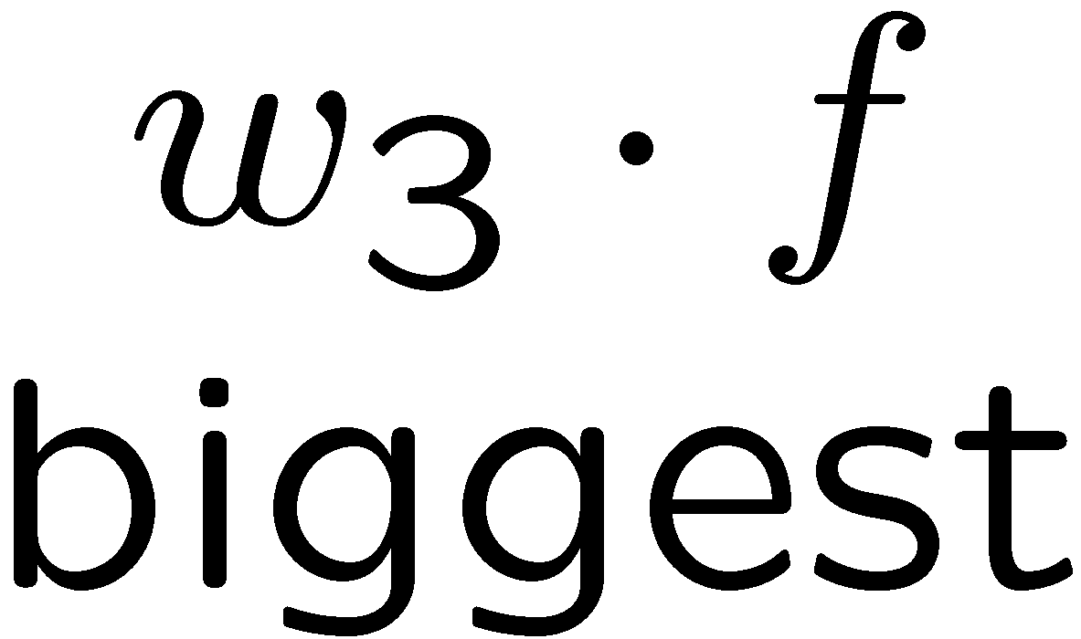
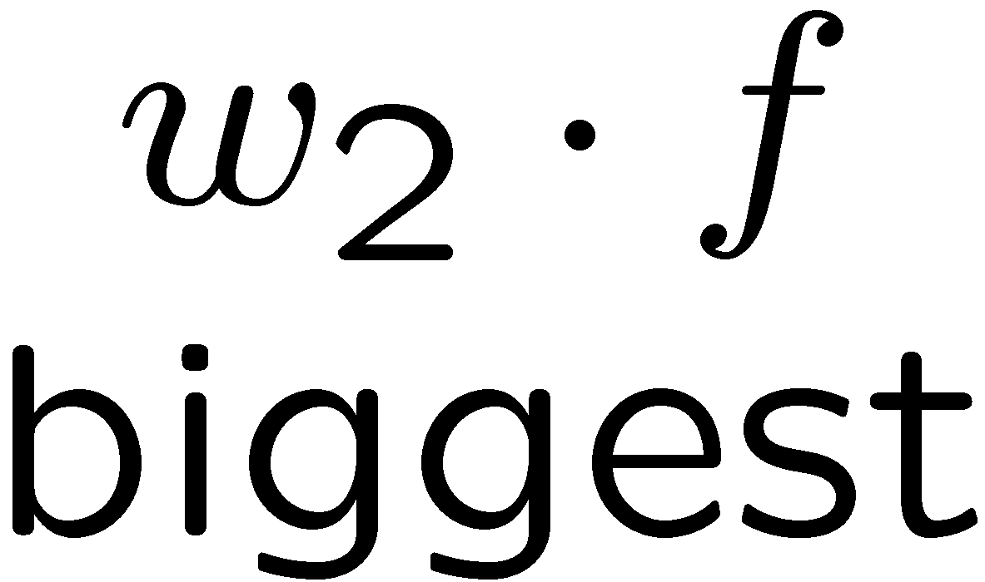
Multiclass Logistic Regression
Recall Perceptron:
A weight vector for each class:
Score (activation) of a class y:
Prediction highest score wins
How to make the scores into probabilities?
original activations
softmax activations

Slide 19
Multi-Class Probabilistic Decisions: Example
Suppose w₁ = [–3, 4, 2], w₂ = [2, 2, 7], w₃ = [0, –1, 0], and x = [1, 2, 0]
What label will be selected if we classify deterministically?
w₁⋅x = 5, and w₂⋅x = 6, and w₃⋅x = –2
w₂⋅x has the highest score, so the classifier guesses class 2
What are the probabilities of each label if we classify probabilistically?
Probability of class 1: e⁵ / (e⁵ + e⁶ + e^{–2}) = 0.2689
Probability of class 2: e⁶ / (e⁵ + e⁶ + e^{–2}) = 0.7310
Probability of class 3: e^{–2} / (e⁵ + e⁶ + e^{–2}) = 0.0002

Slide 20
Best w?
Recall maximum likelihood estimation: Choose the w value that maximizes the probability of the observed (training) data

Slide 21
Best w?
Maximum likelihood estimation:
with:
= Multi-Class Logistic Regression

Slide 22
Multi-Class Logistic Regression Example
What function are we trying to maximize for this training data?
Data point [2, 1] is class Red
Data point [0, –2] is class Green
Data point [–1, –1] is class Blue

Slide 23
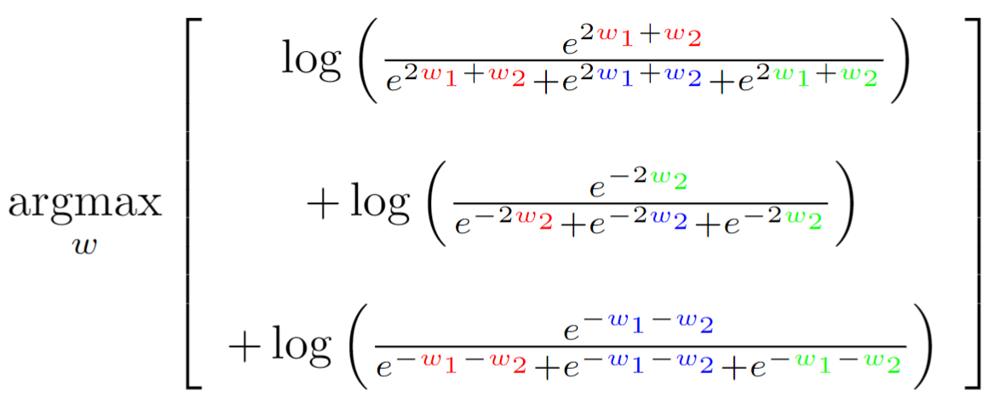
Multi-Class Logistic Regression Example
What function are we trying to maximize for this training data?
Data point [2, 1] is class Red
Data point [0, –2] is class Green
Data point [–1, –1] is class Blue
Log probability of [2, 1] being red
Log probability of [0,–2] being green
Log probability of [–1, –1] being blue
Notes:
$$\argmax_w \left[\begin{array}{c}\ \ \log\left(\frac{e^{2{\color{red} w_1} + {\color{red} w_2}}}{e^{2{\color{red} w_1} + {\color{red} w_2}} + e^{2{\color{blue} w_1} + {\color{blue} w_2}} + e^{2{\color{green} w_1} + {\color{green} w_2}}}\right) \\ \\+ \log\left(\frac{e^{-2{\color{green} w_2}}}{e^{-2{\color{red} w_2}} + e^{-2{\color{blue} w_2}} + e^{-2{\color{green} w_2}}}\right) \\ \\+ \log\left(\frac{e^{-{\color{blue} w_1} - {\color{blue} w_2}}}{e^{-{\color{red} w_1} - {\color{red} w_2}} + e^{-{\color{blue} w_1} - {\color{blue} w_2}} + e^{-{\color{green} w_1} - {\color{green} w_2}}}\right)\end{array}\right]$$

Slide 24
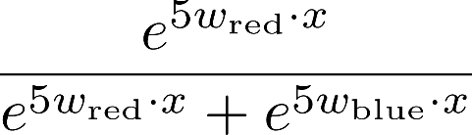
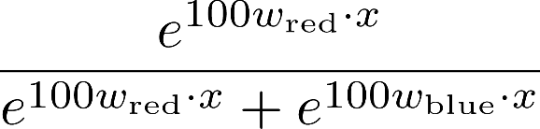
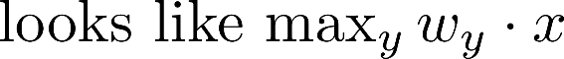
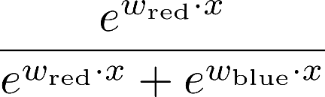
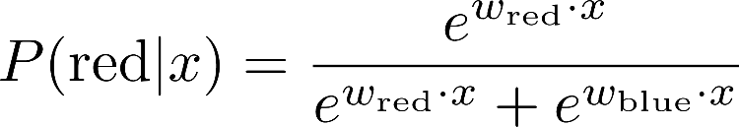
Softmax with Different Bases

Slide 25
Softmax and Sigmoid
Recall: Binary perceptron is a special case of multi-class perceptron
Multi-class: Compute for each class y, pick class with the highest activation
Binary case: Let the weight vector of +1 be w (which we learn). Let the weight vector of -1 always be 0 (constant).
Binary classification as a multi-class problem: Activation of negative class is always 0. If w · f is positive, then activation of +1 (w · f) is higher than -1 (0). If w · f is negative, then activation of -1 (0) is higher than +1 (w · f).
Softmax
Sigmoid
with w_{red} = 0 becomes:

Slide 26
Next Lecture
Optimization
i.e., how do we solve:

Slide 27
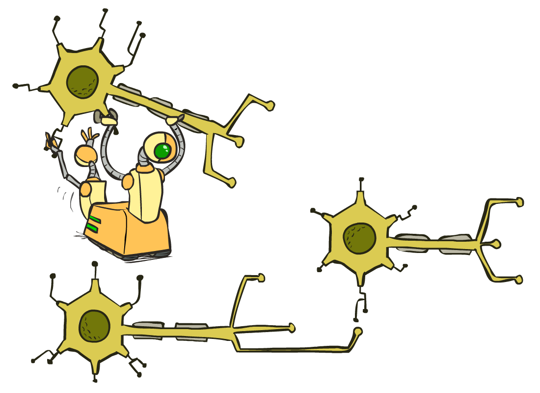
CS 188: Artificial Intelligence
Optimization and Neural Nets
Spring 2023 --- University of California, Berkeley
[These slides were created by Dan Klein and Pieter Abbeel for CS188 Intro to AI at UC Berkeley. All CS188 materials are available at http://ai.berkeley.edu.]
Notes:
Please retain proper attribution, including the reference to ai.berkeley.edu. Thanks!

Slide 28
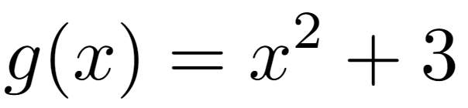
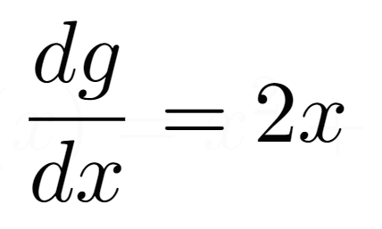
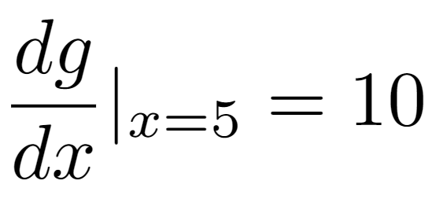
Review: Derivatives and Gradients
What is the derivative of the function ?
What is the derivative of g(x) at x=5?

Slide 29
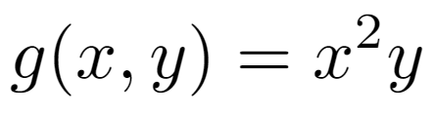
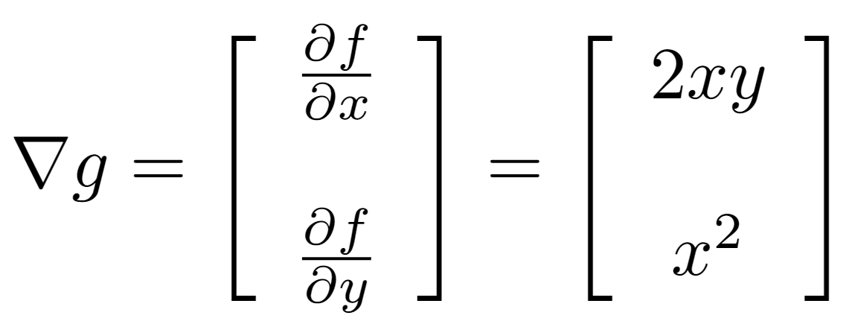
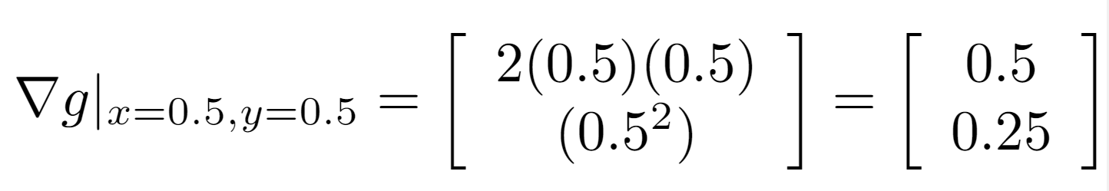
Review: Derivatives and Gradients
What is the gradient of the function ?
Recall: Gradient is a vector of partial derivatives with respect to each variable
What is the derivative of g(x, y) at x=0.5, y=0.5?

Slide 30

Hill Climbing
Recall from CSPs lecture: simple, general idea
Start wherever
Repeat: move to the best neighboring state
If no neighbors better than current, quit
What’s particularly tricky when hill-climbing for multiclass logistic regression?
Optimization over a continuous space
Infinitely many neighbors!
How to do this efficiently?

Slide 31

1-D Optimization
Could evaluate and
Then step in best direction
Or, evaluate derivative:
Tells which direction to step into

Slide 32
2-D Optimization
Source: offconvex.org

Slide 33
Gradient Ascent
Perform update in uphill direction for each coordinate
The steeper the slope (i.e. the higher the derivative) the bigger the step for that coordinate
E.g., consider:
Updates:
Updates in vector notation:
with:
= gradient

Slide 34
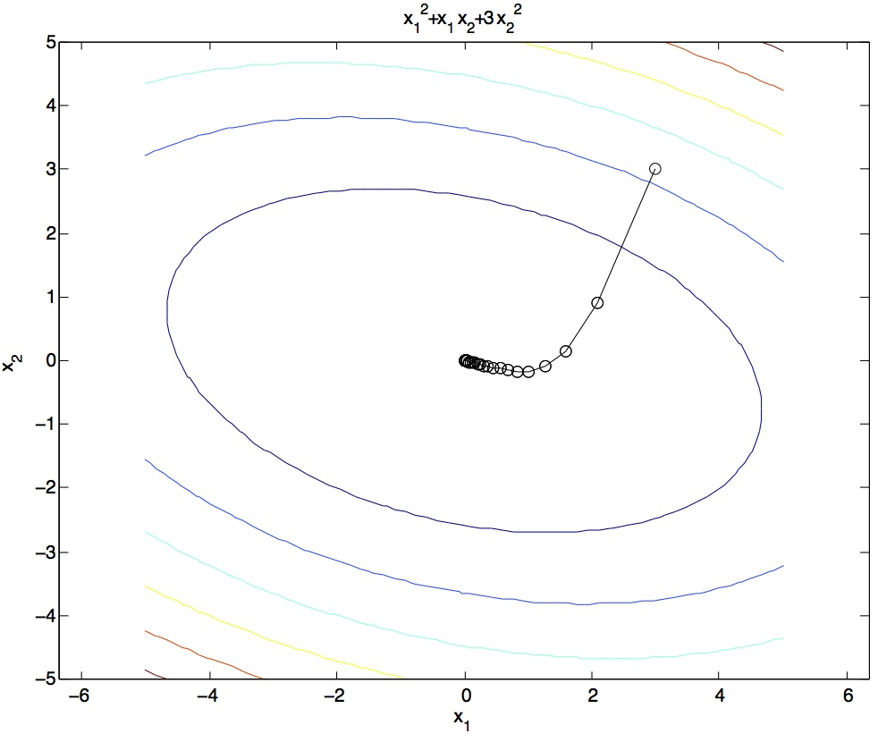
Gradient Ascent
Idea:
Start somewhere
Repeat: Take a step in the gradient direction
Figure source: Mathworks

Slide 35
What is the Steepest Direction?*
First-Order Taylor Expansion:
Steepest Descent Direction:
Recall: →
Hence, solution:
Gradient direction = steepest direction!

Slide 36
Gradient in n dimensions

Slide 37
Optimization Procedure: Gradient Ascent
init
for iter = 1, 2, …
: learning rate --- tweaking parameter that needs to be chosen carefully
How? Try multiple choices
Crude rule of thumb: update changes about 0.1 – 1 %

Slide 38
Batch Gradient Ascent on the Log Likelihood Objective
init
for iter = 1, 2, …

Slide 39
Stochastic Gradient Ascent on the Log Likelihood Objective
Observation: once gradient on one training example has been computed, might as well incorporate before computing next one
init
for iter = 1, 2, …
pick random j

Slide 40
Mini-Batch Gradient Ascent on the Log Likelihood Objective
Observation: gradient over small set of training examples (=mini-batch) can be computed in parallel, might as well do that instead of a single one
init
for iter = 1, 2, …
pick random subset of training examples J

Slide 41
How about computing all the derivatives?
We’ll talk about that once we covered neural networks, which are a generalization of logistic regression

Slide 42
Neural Network Architectures
Brand new untested slides ahead – apologies for any typos/mistakes!

Slide 43
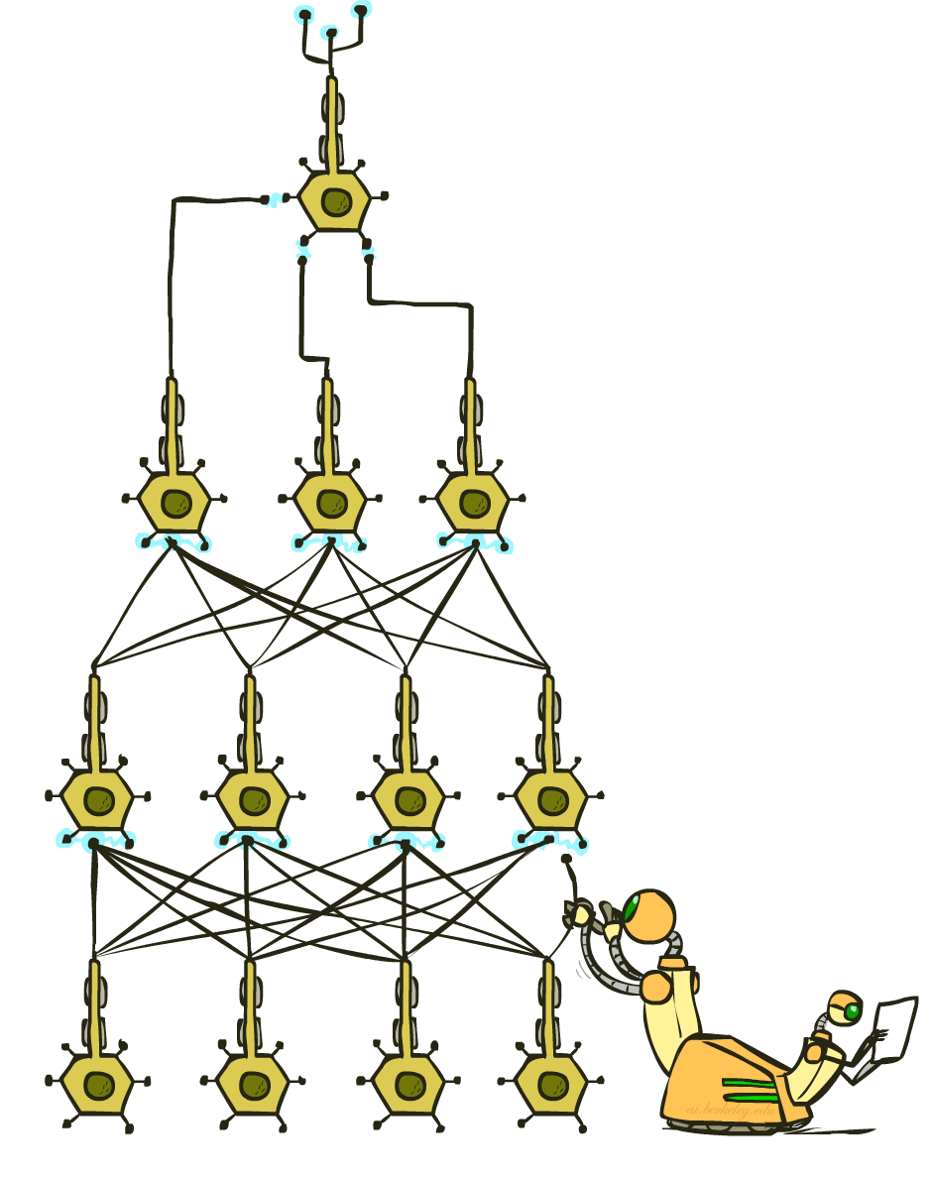
Manual Feature Design vs. Deep Learning
Manual feature design requires:
Domain-specific expertise
Domain-specific effort
What if we could learn the features, too?
Deep Learning
Notes:
43

Slide 44
Review: Perceptron
w₁
x₁
Σ
w₂
>0?
x₂
y
w₃
x₃
Notes:
$$y = \begin{cases}1 & w_1 x_1 + w_2 x_2 + w_3 x_3 > 0 \\0 & \text{otherwise}\end{cases}$$
44

Slide 45
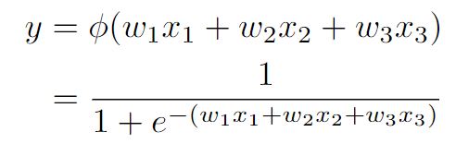
Review: Perceptron with Sigmoid Activation
w₁
x₁
Σ
w₂
>0?
x₂
y
w₃
x₃
Notes:
\begin{align*} y &= \phi(w_1 x_1 + w_2 x_2 + w_3 x_3) \\ &= \frac{1}{1 + e^{-(w_1 x_1 + w_2 x_2 + w_3 x_3)}}\end{align*}
45

Slide 46
2-Layer, 2-Neuron Neural Network
w₁₁
Σ
w₂₁
>0?
x₁
w₁
w₃₁
Σ
w₁₂
y
x₂
w₂
Σ
w₂₂
>0?
x₃
w₃₂
Notes:
46

Slide 47
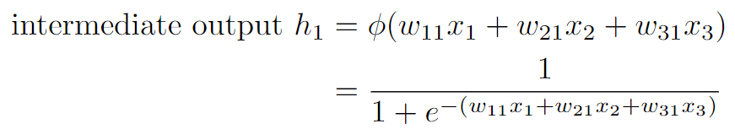
2-Layer, 2-Neuron Neural Network
w₁₁
Σ
w₂₁
>0?
intermediate output h₁
x₁
w₁
w₃₁
Σ
w₁₂
y
x₂
w₂
Σ
w₂₂
>0?
x₃
w₃₂
Notes:
\begin{align*} \text{intermediate output } h_1 &= \phi(w_{11} x_1 + w_{21} x_2 + w_{31} x_3) \\ &= \frac{1}{1 + e^{-(w_{11} x_1 + w_{21} x_2 + w_{31} x_3)}}\end{align*}
47

Slide 48
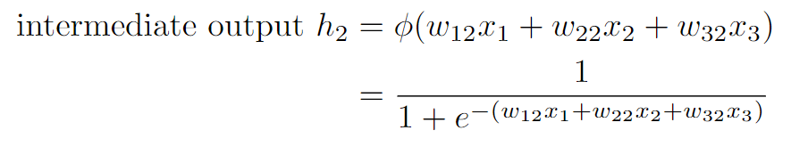
2-Layer, 2-Neuron Neural Network
w₁₁
Σ
w₂₁
>0?
intermediate output h₁
x₁
w₁
w₃₁
Σ
w₁₂
y
x₂
w₂
Σ
w₂₂
>0?
x₃
w₃₂
intermediate output h₂
Notes:
\begin{align*} \text{intermediate output } h_2 &= \phi(w_{12} x_1 + w_{22} x_2 + w_{32} x_3) \\ &= \frac{1}{1 + e^{-(w_{12} x_1 + w_{22} x_2 + w_{32} x_3)}}\end{align*}
48

Slide 49
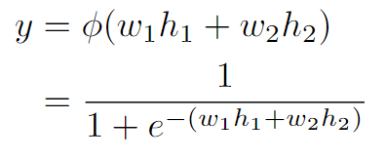
2-Layer, 2-Neuron Neural Network
w₁₁
Σ
w₂₁
>0?
intermediate output h₁
x₁
w₁
w₃₁
Σ
w₁₂
y
x₂
w₂
Σ
w₂₂
>0?
x₃
w₃₂
intermediate output h₂
Notes:
\begin{align*} y &= \phi(w_{1} h_1 + w_{2} h_2) \\ &= \frac{1}{1 + e^{-(w_{1} h_1 + w_{2} h_2 )}}\end{align*}
49

Slide 50
2-Layer, 2-Neuron Neural Network
w₁₁
Σ
w₂₁
>0?
intermediate output h₁
x₁
w₁
w₃₁
Σ
w₁₂
y
x₂
w₂
Σ
w₂₂
>0?
x₃
w₃₂
intermediate output h₂
Notes:
\begin{align*} y &= \phi(w_{1} h_1 + w_{2} h_2) \\ &= \phi(w_{1} \phi(w_{11} x_1 + w_{21} x_2 + w_{31} x_3) + w_{2} \phi(w_{12} x_1 + w_{22} x_2 + w_{32} x_3))\end{align*}
50

Slide 51
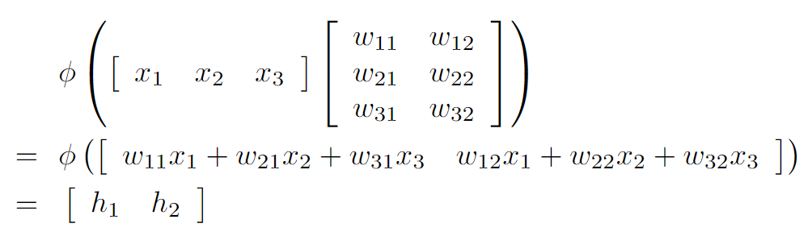
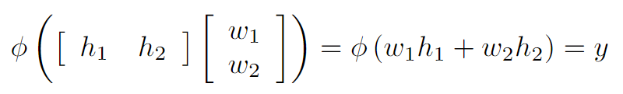
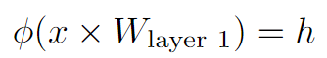
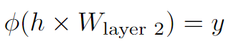
2-Layer, 2-Neuron Neural Network
The same equation, formatted with matrices:
The same equation, formatted more compactly by introducing variables representing each matrix:
Notes:
\begin{align*}& \ \ \phi\left(\left[ \begin{array}{ccc}x_1 & x_2 & x_3\end{array}\right]\left[ \begin{array}{cc}w_{11} & w_{12} \\w_{21} & w_{22} \\w_{31} & w_{32} \\\end{array}\right]\right) \\=& \ \ \phi\left(\left[ \begin{array}{cc}w_{11} x_1 + w_{21} x_2 + w_{31} x_3 &w_{12} x_1 + w_{22} x_2 + w_{32} x_3\end{array}\right]\right) \\=& \ \ \left[ \begin{array}{cc}h_1 &h_2\end{array}\right] \end{align*}
$$\phi\left(\left[ \begin{array}{cc}h_1 & h_2\end{array}\right]\left[ \begin{array}{c}w_1 \\ w_2\end{array}\right]\right)= \phi\left(w_1 h_1 + w_2 h_2\right)= y$$$$\phi(x \times W_{\text{layer 1}}) = h$$$$\phi(h \times W_{\text{layer 2}}) = y$$
51

Slide 52
2-Layer, 2-Neuron Neural Network
Shape (1, 3).
Input feature vector.
Shape (3, 2).
Weights to be learned.
Shape (1, 2).
Outputs of layer 1, inputs to layer 2.
Shape (1, 2).
Outputs of layer 1, inputs to layer 2.
Shape (2, 1).
Weights to be learned.
Shape (1, 1).
Output of network.
Notes:
52

Slide 53
2-Layer, 3-Neuron Neural Network
w₁₁
Σ
w₂₁
>0?
w₃₁
w₁
x₁
w₁₂
Σ
Σ
w₂₂
>0?
w₂
x₂
y
w₃₂
w₃
x₃
w₁₃
Σ
w₂₃
>0?
w₃₃
Notes:
53

Slide 54
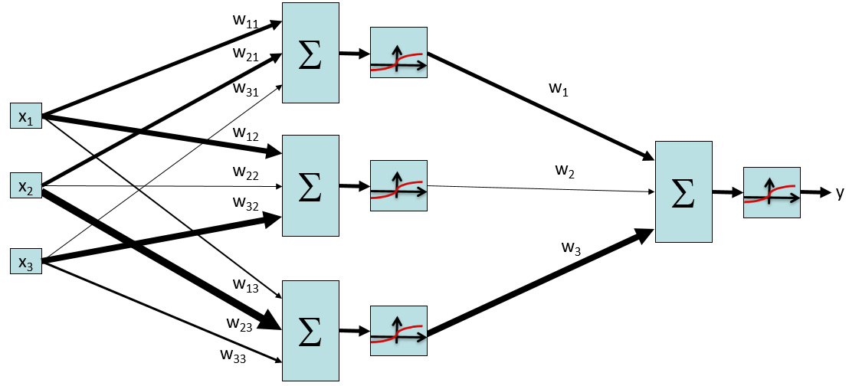
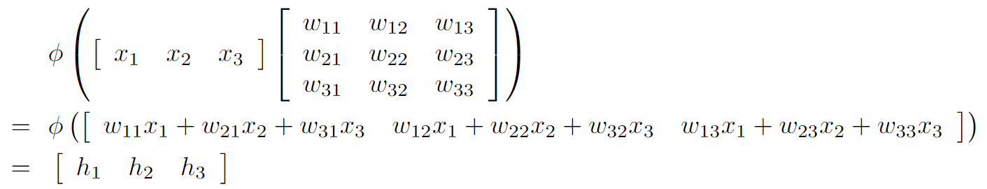
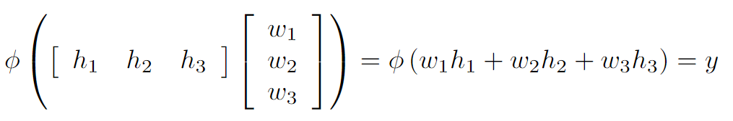
2-Layer, 3-Neuron Neural Network
Notes:
\begin{align*}& \ \ \phi\left(\left[ \begin{array}{ccc}x_1 & x_2 & x_3\end{array}\right]\left[ \begin{array}{ccc}w_{11} & w_{12} & w_{13} \\w_{21} & w_{22} & w_{23} \\w_{31} & w_{32} & w_{33} \\\end{array}\right]\right) \\=& \ \ \phi\left(\left[ \begin{array}{ccc}w_{11} x_1 + w_{21} x_2 + w_{31} x_3 &w_{12} x_1 + w_{22} x_2 + w_{32} x_3 &w_{13} x_1 + w_{23} x_2 + w_{33} x_3\end{array}\right]\right) \\=& \ \ \left[ \begin{array}{ccc}h_1 &h_2 &h_3\end{array}\right] \end{align*}$$\phi\left(\left[ \begin{array}{ccc}h_1 & h_2 & h_3\end{array}\right]\left[ \begin{array}{c}w_1 \\ w_2 \\ w_3\end{array}\right]\right)= \phi\left(w_1 h_1 + w_2 h_2 + w_3 h_3\right)= y$$
54

Slide 55
2-Layer, 3-Neuron Neural Network
Shape (1, 3).
Input feature vector.
Shape (3, 3).
Weights to be learned
Shape (1, 3).
Outputs of layer 1, inputs to layer 2.
Shape (1, 3).
Outputs of layer 1, inputs to layer 2.
Shape (3, 1).
Weights to be learned.
Shape (1, 1).
Output of network.
Notes:
55

Slide 56
Generalize: Number of hidden neurons
w₁₁
Σ
w₂₁
>0?
w₃₁
w₁
x₁
w₁₂
Σ
Σ
w₂₂
>0?
w₂
x₂
y
w₃₂
…
w_{n}
x₃
w_{1n}
Σ
w_{2n}
>0?
w_{3n}
The hidden layer doesn’t necessarily need to have 3 neurons; it could have any arbitrary number n neurons.
Notes:
56

Slide 57
Generalize: Number of hidden neurons
Shape (1, 3).
Input feature vector.
Shape (3, n).
Weights to be learned
Shape (1, n).
Outputs of layer 1, inputs to layer 2.
Shape (1, n).
Outputs of layer 1, inputs to layer 2.
Shape (n, 1).
Weights to be learned.
Shape (1, 1).
Output of network.
The hidden layer doesn’t necessarily need to have 3 neurons; it could have any arbitrary number n neurons.
Notes:
57

Slide 58
Generalize: Number of input features
w₁₁
Σ
x₁
w₂₁
>0?
w₃₁
w₁
x₂
w_{dim(x)1}
Σ
…
x₃
y
w_{1n}
…
w_{n}
w_{2n}
w_{3n}
Σ
x_{dim(x)}
>0?
w_{dim(x)n}
The input feature vector doesn’t necessarily need to have 3 features; it could have some arbitrary number dim(x) of features.
Notes:
58

Slide 59
Generalize: Number of input features
Shape (1, dim(x)).
Input feature vector.
Shape (dim(x), n).
Weights to be learned
Shape (1, n).
Outputs of layer 1, inputs to layer 2.
Shape (1, n).
Outputs of layer 1, inputs to layer 2.
Shape (n, 1).
Weights to be learned.
Shape (1, 1).
Output of network.
The input feature vector doesn’t necessarily need to have 3 features; it could have some arbitrary number dim(x) of features.
Notes:
59

Slide 60
Generalize: Number of outputs
w₁₁
Σ
x₁
w₂₁
>0?
w₃₁
Σ
x₂
y₁
W_{dim(x)1}
…
…
x₃
w_{1n}
Σ
…
w_{2n}
y_{dim(y)}
w_{3n}
Σ
x_{dim(x)}
>0?
w_{dim(x)n}
The output doesn’t necessarily need to be just one number; it could be some arbitrary dim(y) length vector.
Notes:
60

Slide 61
Generalize: Number of input features
Shape (1, dim(x)).
Input feature vector.
Shape (dim(x), n).
Weights to be learned
Shape (1, n).
Outputs of layer 1, inputs to layer 2.
Shape (1, n).
Outputs of layer 1, inputs to layer 2.
Shape (n, dim(y)).
Weights to be learned.
Shape (1, dim(y)).
Output of network.
The output doesn’t necessarily need to be just one number; it could be some arbitrary dim(y) length vector.
Notes:
61

Slide 62
Generalized 2-Layer Neural Network
Layer 1 has weight matrix with shape (dim(x), n). These are the weights for n neurons, each taking dim(x) features as input.
This transforms a dim(x)-dimensional input vector into an n-dimensional output vector.
Shape (1, dim(x)).
Input feature vector.
Shape (dim(x), n).
Weights to be learned
Shape (1, n).
Outputs of layer 1, inputs to layer 2.
Layer 2 has weight matrix with shape (n, dim(y)). These are the weights for dim(y) neurons, each taking n features as input.
This transforms an n-dimensional input vector into a dim(y)-dimensional output vector.
Shape (1, n).
Outputs of layer 1, inputs to layer 2.
Shape (n, dim(y)).
Weights to be learned.
Shape (1, dim(y)).
Output of network.
Big idea: The shape of a weight matrix is determined by the dimensions of the input and output of that layer.
Notes:
62

Slide 63
3-Layer, 3-Neuron Neural Network
Σ
Σ
>0?
>0?
x₁
Σ
Σ
Σ
>0?
>0?
y
x₂
x₃
Σ
Σ
>0?
>0?
Notes:
63

Slide 64
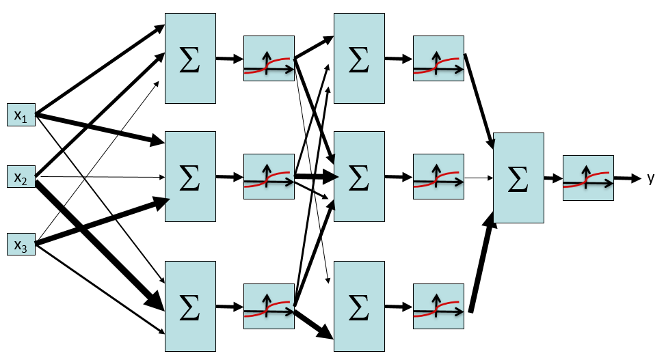
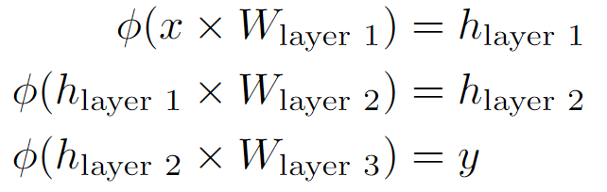
3-Layer, 3-Neuron Neural Network
Layer 1:
x has shape (1, 3). Input vector, 3-dimensional.
W_{layer 1} has shape (3, 3). Weights for 3 neurons, each taking in a 3-dimensional input vector.
h_{layer 1} has shape (1, 3). Outputs of the 3 neurons at this layer.
Layer 2:
h_{layer 1} has shape (1, 3). Outputs of the 3 neurons from the previous layer.
W_{layer 2} has shape (3, 3). Weights for 3 new neurons, each taking in the 3 previous perceptron outputs.
h_{layer 2} has shape (1, 3). Outputs of the 3 new neurons at this layer.
Layer 3:
h_{layer 2} has shape (1, 3). Outputs from the previous layer.
W_{layer 3} has shape (3, 1). Weights for 1 final neuron, taking in the 3 previous perceptron outputs.
y has shape (1, 1). Output of the final neuron.
Notes:
64

Slide 65
Generalized 3-Layer Neural Network
Layer 1:
x has shape (1, dim(x))
W_{layer 1} has shape (dim(x), dim(L1))
h_{layer 1} has shape (1, dim(L1))
Layer 2:
h_{layer 1} has shape (1, dim(L1))
W_{layer 2} has shape (dim(L1), dim(L2))
h_{layer 2} has shape (1, dim(L2))
Layer 3:
h_{layer 2} has shape (1, dim(L2))
W_{layer 3} has shape (dim(L2), dim(y))
y has shape (1, dim(y))
Notes:
65

Slide 66
Multi-Layer Neural Network
Σ
Σ
Σ
>0?
>0?
>0?
…
x₁
Σ
Σ
Σ
Σ
>0?
>0?
>0?
x₂
…
y
Note: Sometimes we don’t apply the non-linear function in the last layer.
x₃
Σ
Σ
Σ
>0?
>0?
…
>0?
Notes:
66

Slide 67
Multi-Layer Neural Network
Input to a layer: some dim(x)-dimensional input vector
Output of a layer: some dim(y)-dimensional output vector
dim(y) is the number of neurons in the layer (1 output per neuron)
Process of converting input to output:
Multiply the (1, dim(x)) input vector with a (dim(x), dim(y)) weight vector. The result has shape (1, dim(y)).
Apply some non-linear function (e.g. sigmoid) to the result. The result still has shape (1, dim(y)).
Big idea: Chain layers together
The input could come from a previous layer’s output
The output could be used as the input to the next layer

Slide 68
Deep Neural Network
x₁
x₂
…
x₃
…
…
…
…
…
x_{L}
g = nonlinear activation function

Slide 69
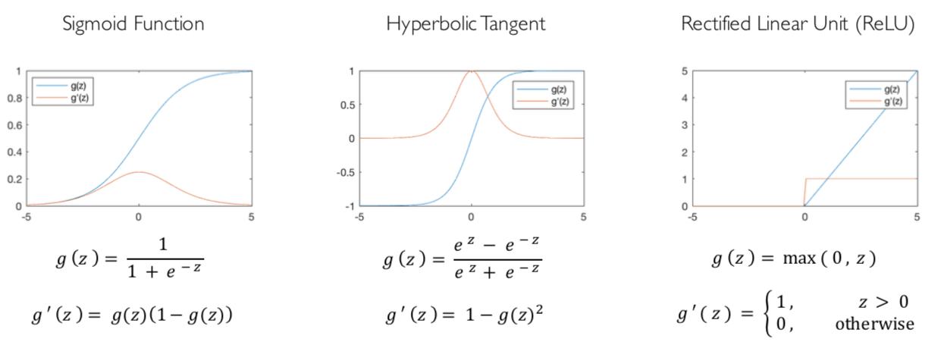
Common Activation Functions
[source: MIT 6.S191 introtodeeplearning.com]

Slide 70
Batch Sizes
w₁₁
Σ
w₂₁
>0?
intermediate output h₁₁
x₁₁
w₁
w₃₁
Σ
w₁₂
y₁
x₂₁
w₂
Σ
w₂₂
>0?
x₃₁
w₃₂
intermediate output h₂₁
w₁₁
Σ
w₂₁
>0?
intermediate output h₁₂
x₁₂
w₁
w₃₁
Σ
w₁₂
y₂
x₂₂
w₂
Σ
w₂₂
>0?
x₃₂
w₃₂
intermediate output h₂₂
Notes:
70

Slide 71
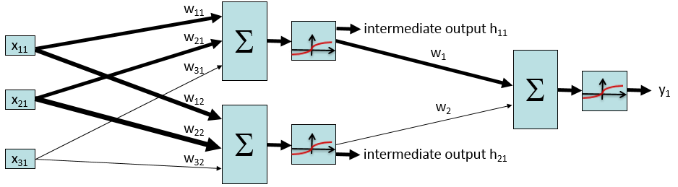
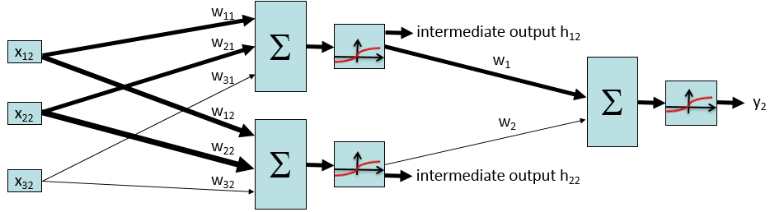
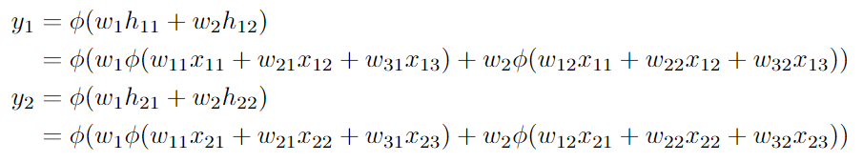
Batch Sizes
We’re not changing the architecture; we’re just running the 2-neuron, 2-layer network twice to classify 2 inputs.
Notes:
\begin{align*} y_1 &= \phi(w_{1} h_{11} + w_{2} h_{12}) \\ &= \phi(w_{1} \phi(w_{11} x_{11} + w_{21} x_{12} + w_{31} x_{13}) + w_{2} \phi(w_{12} x_{11} + w_{22} x_{12} + w_{32} x_{13})) \\y_2 &= \phi(w_{1} h_{21} + w_{2} h_{22}) \\ &= \phi(w_{1} \phi(w_{11} x_{21} + w_{21} x_{22} + w_{31} x_{23}) + w_{2} \phi(w_{12} x_{21} + w_{22} x_{22} + w_{32} x_{23}))\end{align*}
71

Slide 72
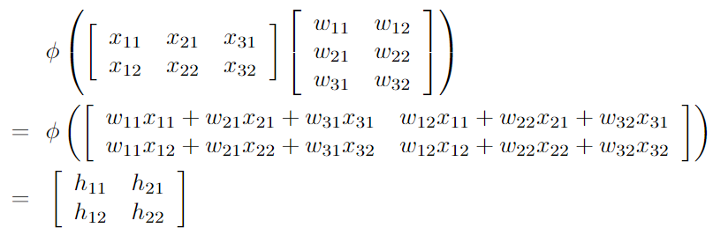

Batch Sizes
Rewriting in matrix form:
Notes:
\begin{align*}& \ \ \phi\left(\left[ \begin{array}{ccc}x_{11} & x_{21} & x_{31} \\x_{12} & x_{22} & x_{32}\end{array}\right]\left[ \begin{array}{cc}w_{11} & w_{12} \\w_{21} & w_{22} \\w_{31} & w_{32} \\\end{array}\right]\right) \\=& \ \ \phi\left(\left[ \begin{array}{cc}w_{11} x_{11} + w_{21} x_{21} + w_{31} x_{31} & w_{12} x_{11} + w_{22} x_{21} + w_{32} x_{31} \\w_{11} x_{12} + w_{21} x_{22} + w_{31} x_{32} & w_{12} x_{12} + w_{22} x_{22} + w_{32} x_{32}\end{array}\right]\right) \\=& \ \ \left[ \begin{array}{cc}h_{11} & h_{21} \\h_{12} & h_{22}\end{array}\right] \end{align*}$$\phi\left(\left[ \begin{array}{cc}h_{11} & h_{21} \\h_{12} & h_{22}\end{array}\right]\left[ \begin{array}{c}w_1 \\ w_2\end{array}\right]\right)= \phi\left(\left[ \begin{array}{c}w_{1} h_{11} + w_{2} h_{21} \\w_{1} h_{12} + w_{2} h_{22}\end{array}\right]\right)= \left[ \begin{array}{c}y_1 \\y_2\end{array}\right]$$
72

Slide 73
Batch Sizes
Shape (batch, dim(x)).
Input feature vector.
Shape (dim(x), n).
Weights to be learned
Shape (batch, n).
Outputs of layer 1, inputs to layer 2.
Shape (batch, n).
Outputs of layer 1, inputs to layer 2.
Shape (n, dim(y)).
Weights to be learned.
Shape (batch, dim(y)).
Output of network.
Big idea: We can “stack” inputs together to classify multiple inputs at once. The result is multiple outputs “stacked” together.
Notes:
73

Slide 74
Multi-Layer Network, with Batches
Input to a layer: batch different dim(x)-dimensional input vectors
Output of a layer: batch different dim(y)-dimensional output vectors
dim(y) is the number of neurons in the layer (1 output per neuron)
Process of converting input to output:
Multiply the (batch, dim(x)) input matrix with a (dim(x), dim(y)) weight vector. The result has shape (batch, dim(y)).
Apply some non-linear function (e.g. sigmoid) to the result. The result still has shape (batch, dim(y)).
Big idea: Stack inputs/outputs to batch them
The multiplication by weights and non-linear function will be applied to each row (data point in the batch) separately.

Slide 75
Training Neural Networks

Slide 76
Training Neural Networks
Step 1: For each input in the training (sub)set x, predict a classification y using the current weights
Step 2: Compare predictions with the true y values, using a loss function
Higher value of loss function = bad model
Lower value of loss function = good model
Example: zero-one loss: count the number of misclassified inputs
Example: log loss (derived from maximum likelihood; more on this soon)
Example: sum of squared errors (if you’re solving a regression problem)
Step 3: Use numerical method (e.g. gradient descent) to minimize loss
Loss is a function of the weights. Optimization goal: find weights that minimize loss

Slide 77

Log Loss Function
Recall: loss function is a measure of how far off our model is
Higher value of loss function = bad model
Lower value of loss function = good model
Log loss function for binary classification:
y_{i} = The true class of the ith data point in the training dataset
p_{i} = The probability of positive class, predicted by our classifier
Each data point contributes some loss. The total loss is the sum over all data points.
Note: Log loss is a function of the weights
Changing the weights changes the predictions p_{i}. The y_{i} do not change.

Slide 78


Log Loss Function
Log loss function for a single data point:
Case I: True class is y = 1
Log loss function becomes just –log(p)
If classifier gives p near 0: The model was confident in guessing y=0 Bad model → high loss value
If classifier gives p near 1: The model was confident in guessing y=1 Good model → low loss value

Slide 79

Log Loss Function
Log loss function for a single data point:
Case II: True class is y = 0
Log loss function becomes just –log(1-p)
If classifier gives p near 0: The model was confident in guessing y=0 Good model → low loss value
If classifier gives p near 1: The model was confident in guessing y=1 Bad model → high loss value
Note: This equation uses y=0, not y=-1, for the negative class

Slide 80
Log Loss Example
Data point 1: True class y=1. We predicted p=0.1 probability it’s the positive class.
Intuitively: Our guess is bad. We should have guessed closer to p=1.
This contributes –log(0.1) = 1 to the loss function.
Data point 2: True class y=0. We predicted p=0 probability it’s the positive class.
Intuitively: Our guess was perfect. We were certain it was y=0.
This contributes –log(1.0) = 0 to our loss function.
Data point 3: True class y=1. We predicted 0.8 probability it’s the positive class.
Intuitively: Our guess was pretty good, but not perfect.
This contributes –log(0.8) = 0.1 to the loss function.
Total loss: 1 + 0 + 0.1 = 1.1
Goal: Find the weights that lead to the probabilities that minimize this loss function

Slide 81

Optimization Procedure: Gradient Descent
init
for iter = 1, 2, …
where
and is computed by running the network on input x_{i} and weights w
: learning rate --- tweaking parameter that needs to be chosen carefully

Slide 82
Computing Gradients
How do we compute gradients of these loss functions?
Repeated application of the chain rule:
If
Then
→ Derivatives can be computed by following well-defined procedures

Slide 83
Automatic Differentiation
Automatic differentiation software
e.g. Theano, TensorFlow, PyTorch, Chainer
Only need to program the function g(x,y,w)
Can automatically compute all derivatives w.r.t. all entries in w
This is typically done by caching info during forward computation pass of f, and then doing a backward pass = “backpropagation”
Autodiff / Backpropagation can often be done at computational cost comparable to the forward pass
Need to know this exists
How this is done? -- outside of scope of CS188

Slide 84






Backpropagation*
Gradient of at w₁ = 2, w₂ = 3, w₃ = 2
Think of g as a composition of many functions
Then, we can use the chain rule to compute the gradient
g = b + c
b = a × w₂
a = w₁⁴
c = 5w₁
w₁ = 2
^4
a = 16
w₁
×
b = 48
w₂ = 3
w₂
g = 58
+
5
×
c = 10
w₃ = 2
w₃

Slide 85
Properties of Neural Networks

Slide 86
Neural Networks Properties
Theorem (Universal Function Approximators). A two-layer neural network with a sufficient number of neurons can approximate any continuous function to any desired accuracy.
Practical considerations
Can be seen as learning the features
Large number of neurons
Danger for overfitting
(hence early stopping!)

Slide 87

Universal Function Approximation Theorem*
In words: Given any continuous function f(x), if a 2-layer neural network has enough hidden units, then there is a choice of weights that allow it to closely approximate f(x).
Cybenko (1989) “Approximations by superpositions of sigmoidal functions”
Hornik (1991) “Approximation Capabilities of Multilayer Feedforward Networks”
Leshno and Schocken (1991) ”Multilayer Feedforward Networks with Non-Polynomial Activation Functions Can Approximate Any Function”

Slide 88



Universal Function Approximation Theorem*
Cybenko (1989) “Approximations by superpositions of sigmoidal functions”
Hornik (1991) “Approximation Capabilities of Multilayer Feedforward Networks”
Leshno and Schocken (1991) ”Multilayer Feedforward Networks with Non-Polynomial Activation Functions Can Approximate Any Function”

Slide 89
Summary of Key Ideas
Optimize probability of label given input
Continuous optimization
Gradient ascent:
Compute steepest uphill direction = gradient (= just vector of partial derivatives)
Take step in the gradient direction
Repeat (until held-out data accuracy starts to drop = “early stopping”)
Deep neural nets
Last layer = still logistic regression
Now also many more layers before this last layer
= computing the features
→ the features are learned rather than hand-designed
Universal function approximation theorem
If neural net is large enough
Then neural net can represent any continuous mapping from input to output with arbitrary accuracy
But remember: need to avoid overfitting / memorizing the training data → early stopping!
Automatic differentiation gives the derivatives efficiently (how? = outside of scope of 188)

Slide 90

Application: Computer Vision
Notes:
90

Slide 91

Performance
graph credit Matt Zeiler, Clarifai

Slide 92
Performance
graph credit Matt Zeiler, Clarifai

Slide 93
Performance
AlexNet
graph credit Matt Zeiler, Clarifai

Slide 94
Performance
AlexNet
graph credit Matt Zeiler, Clarifai

Slide 95
Performance
AlexNet
graph credit Matt Zeiler, Clarifai

Slide 96
Fun Neural Net Demo Site
Demo-site:
http://playground.tensorflow.org/

Slide 97
Next: More Neural Net Applications!

